Slide 1
Grafted Genetic Algorithm and Traveling Visitor Problem
Seminar work
Milan Djordjevic
Supervisor: Prof. Andrej Brodnik, PhD
Co-Supervisor: Prof. Janez Žibert, PhD
The Faculty of Mathematics, Natural Sciences and Information Technologies

Slide 2
Outline
Motivation
Hypotheses
Introduction
  Traveling Salesman Problem (TSP)
  Methods for Solving TSP
  All-Pairs Shortest Path Problem (APSP)
Grafted GA for the TSP
  Experiments
  Evaluation
Traveling Visitor Problem (TVP)
  Experiments
  Evaluation
Contribution to Science
Conclusions

Slide 3
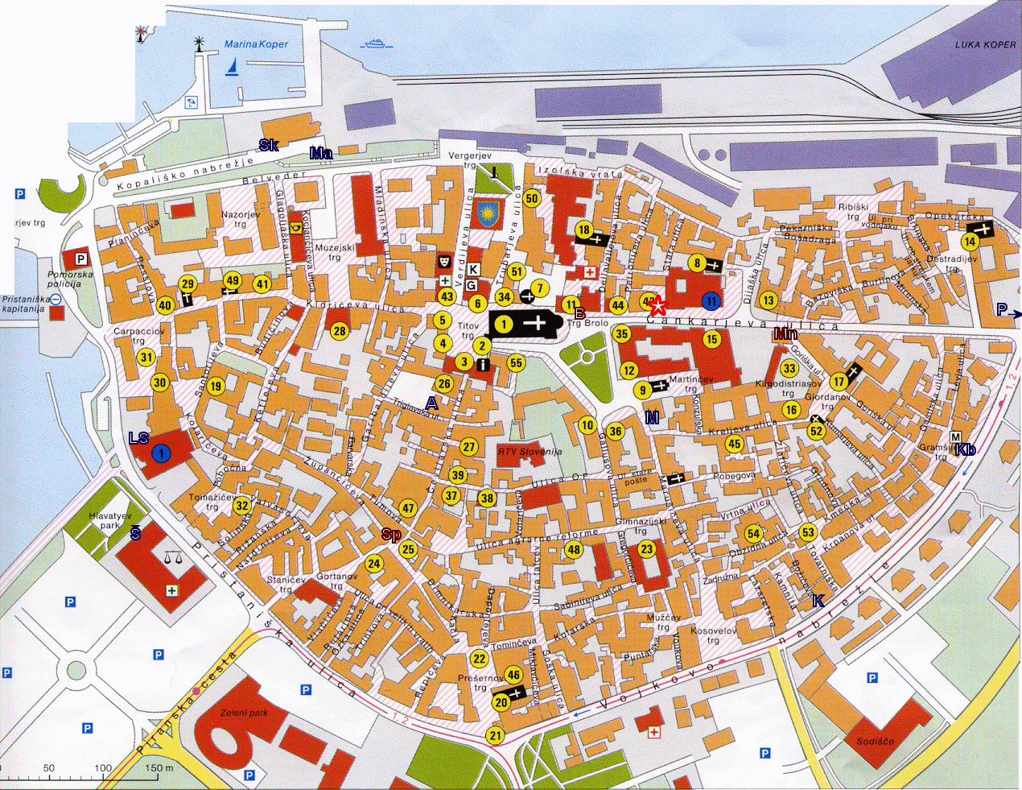
TVP

Slide 4
Hypotheses
Research objective of the thesis is to prove the following hypotheses:
Hypothesis 1: The method for solving of TSP that is made of two independent methods, genetic algorithm and 2-opt heuristic, outperforms each of the combined methods in terms of the quality of solution.
Hypothesis 2: The quality of solution of a special method to the problem of a traveling visitor problem, outperforms algorithms for solving general TSP problem when they are used for solving traveling visitor problem.

Slide 5
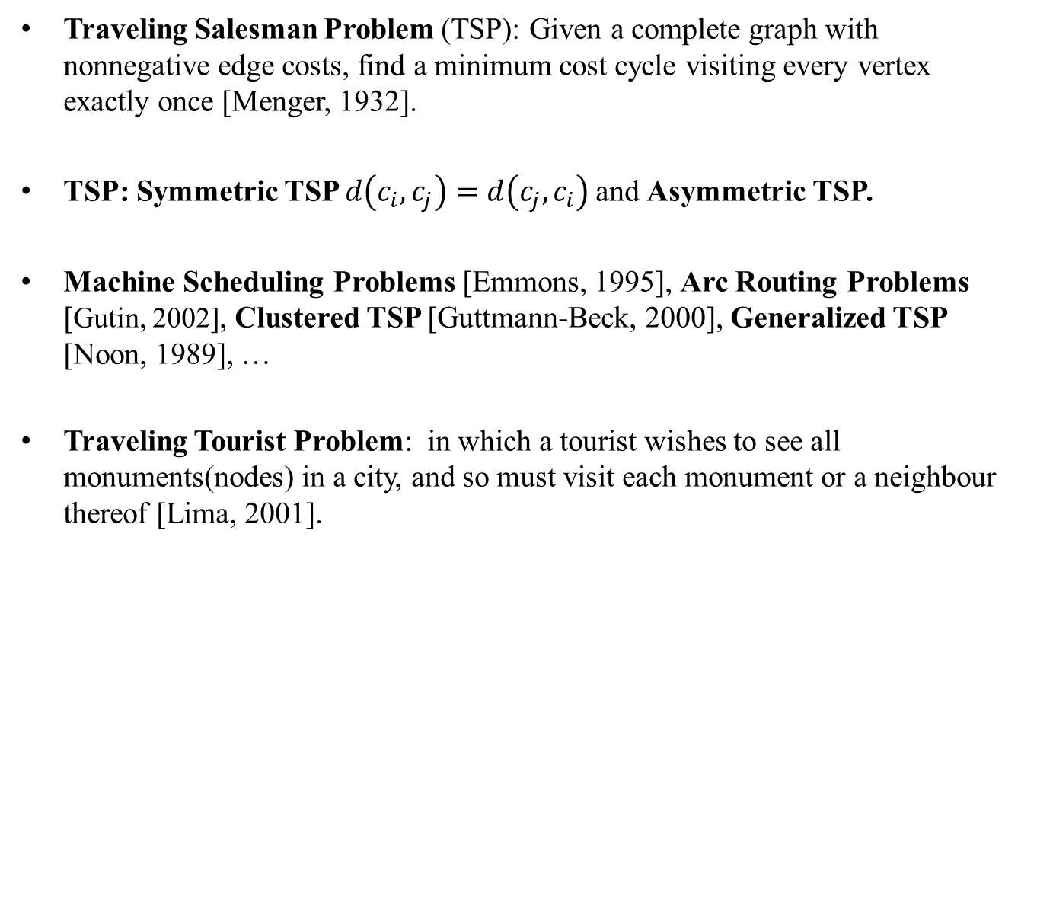
Introduction - TSP
Traveling Salesman Problem (TSP): Given a complete graph with nonnegative edge costs, find a minimum cost cycle visiting every vertex exactly once [Menger, 1932].
TSP: Symmetric TSP $d\left(c_{i}, c_{j}\right)=d\left(c_{j}, c_{i}\right)$and Asymmetric TSP.
Machine Scheduling Problems [Emmons, 1995], Arc Routing Problems [Gutin, 2002], Clustered TSP [Guttmann-Beck, 2000], Generalized TSP [Noon, 1989], …
Traveling Tourist Problem: in which a tourist wishes to see all monuments(nodes) in a city, and so must visit each monument or a neighbour thereof [Lima, 2001].

Slide 6
Introduction - Methods for Solving TSP
The TSP is known to be NP-hard [Johnson, 1979].
Greedy algorithm [Bentley,1992].
A local search algorithm [Flood, 1956].
Genetic Algorithm [Holland, 1975].
Lin-Kernighan Algorithm [Helsgaun, 2002].
The Concorde TSP Solver [Mulder, 2003].

Slide 7
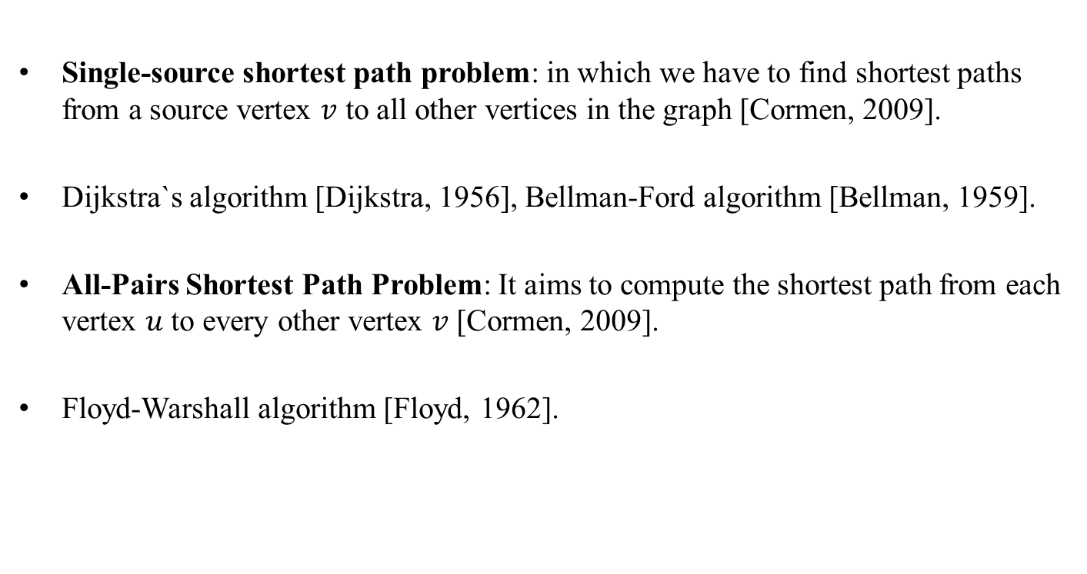
Introduction - APSP
Single-source shortest path problem: in which we have to find shortest paths from a source vertex $v$ to all other vertices in the graph [Cormen, 2009].
Dijkstra`s algorithm [Dijkstra, 1956], Bellman-Ford algorithm [Bellman, 1959].
All-Pairs Shortest Path Problem: It aims to compute the shortest path from each vertex $u$ to every other vertex $v$ [Cormen, 2009].
Floyd-Warshall algorithm [Floyd, 1962].

Slide 8
Outline
Motivation
Hypotheses
Introduction
  Traveling Salesman Problem (TSP)
  Methods for Solving TSP
  All-Pairs Shortest Path Problem (APSP)
Grafted GA for the TSP
  Experiments
  Evaluation
Traveling Visitor Problem (TVP)
  Experiments
  Evaluation
Contribution to Science
Conclusions

Slide 9
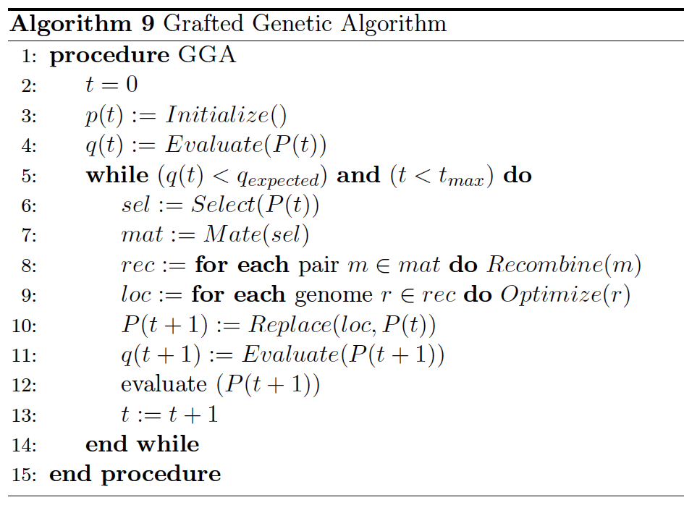
Grafted GA for the TSP
Edge map crossover (EMX): It makes use of a so called edge map [Freisleben, 2001].
Distance preserving crossover (DPX): It attempts to create a new tour with the same distance to both parents [Merz, 1996].

Slide 10
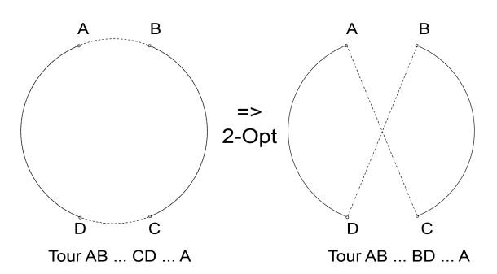
Grafted GA for the TSP
The 2-opt Hybrid searcher is a local optimizer for the TSP that has been grafted into the standard genetic algorithm.
An exchange step consists of removing two edges from the current tour and reconnecting the resulting two paths in the best possible way.

Slide 11
Experiment I
Instances: 20 with different complexity and range from 14 to 150 cities.
Methods: Grafted Genetic Algorithm with edge map crossover (GGAemx) and with a distance preserving crossover (GGAdpx).
Upper bound for the quality: Greedy Heuristic (NN).
Lower bound for the quality: global minima, obtained by Concorde.
2-opt algorithm.
Canonical Genetic Algorithms: GAemx and GAdpx.

Slide 12
Results I

Slide 13
Experiment II
10, 20, 30, 40, 50, 60, 70, 80 and 90 percent of the generations, i.e. level of hybridization.
Three different ways, i.e. place of hybridization: random generations, initial and ending ones.

Slide 14
Results II
Name | GAemc |  | 10 |  |  |  | 20 |  |  |  | 30 |  |  |  | 40 |  |  |  | 50
 |  |  | rnd | begin | end | f.a | rnd | begin | end | f.a | rnd | begin | end | f.a | rnd | begin | end | f.a | rnd | begin | end | f.a
 | q | t | q | q | q | t | q | q | q | t | q | q | q | t | q | q | q | t | q | q | q | t
eil76 | 8.93% | 0.8 | 2.46% | 2.13% | 1.25% | 1.2 | 1.80% | 0.99% | 0.96% | 1.5 | 1.62% | 0.92% | 0.77% | 1.8 | 1.58% | 0.44% | 0.22% | 2.2 | 1.14% | 0.37% | 0.18% | 2.6
pr76 | 5.39% | 0.9 | 0.60% | 0.41% | 0.34% | 1.3 | 0.32% | 0.24% | 0.19% | 1.7 | 0.25% | 0.17% | 0.10% | 2.1 | 0.20% | 0.16% | 0.09% | 2.4 | 0.17% | 0.11% | 0.07% | 2.7
gr96 | 6.46% | 1.7 | 1.68% | 0.78% | 0.70% | 2.3 | 1.37% | 0.59% | 0.55% | 2.9 | 0.94% | 0.59% | 0.55% | 3.6 | 0.78% | 0.59% | 0.55% | 4.2 | 0.82% | 0.55% | 0.47% | 4.9
rat99 | 6.14% | 1.9 | 2.53% | 1.82% | 1.62% | 2.6 | 2.67% | 0.90% | 0.71% | 3.3 | 2.81% | 0.62% | 0.56% | 4.1 | 2.13% | 0.53% | 0.39% | 5.2 | 1.28% | 0.43% | 0.38% | 6.3
kroA100 | 6.67% | 0.6 | 1.09% | 0.73% | 0.38% | 0.9 | 0.84% | 0.38% | 0.33% | 1.2 | 0.19% | 0.22% | 0.12% | 1.5 | 0.18% | 0.08% | 0.03% | 1.8 | 0.16% | 0.03% | 0.02% | 2.1
kroB100 | 7.02% | 0.8 | 1.61% | 1.15% | 1.02% | 1.3 | 1.26% | 0.70% | 0.53% | 1.8 | 0.72% | 0.70% | 0.42% | 2.3 | 0.71% | 0.47% | 0.35% | 2.8 | 0.76% | 0.40% | 0.38% | 3.3
kroC100 | 6.61% | 0.7 | 2.20% | 1.05% | 0.99% | 1.2 | 1.19% | 0.90% | 0.75% | 1.6 | 0.97% | 0.63% | 0.52% | 2.1 | 0.79% | 0.44% | 0.37% | 2.5 | 0.74% | 0.38% | 0.36% | 2.9
kroD100 | 7.67% | 0.8 | 2.20% | 1.87% | 2.11% | 1.3 | 2.39% | 2.02% | 1.47% | 1.8 | 1.44% | 1.17% | 0.97% | 2.3 | 1.26% | 0.89% | 0.67% | 2.8 | 0.97% | 0.54% | 0.46% | 3.3
lin105 | 8.54% | 0.5 | 1.50% | 1.11% | 1.19% | 0.9 | 0.89% | 0.70% | 0.50% | 1.4 | 0.83% | 0.40% | 0.41% | 1.8 | 0.71% | 0.37% | 0.29% | 2.2 | 0.46% | 0.23% | 0.23% | 2.6
ch150 | 8.69% | 5.4 | 2.94% | 2.52% | 2.34% | 6.2 | 2.17% | 1.89% | 1.83% | 6.9 | 1.77% | 1.58% | 1.37% | 7.8 | 1.63% | 1.46% | 1.36% | 8.7 | 1.31% | 1.19% | 0.92% | 9.6
*pr439 | 10.45% | 3.7 | 4.92% | 4.35% | 3.48% | 11 | 4.59% | 3.43% | 2.96% | 18 | 4.04% | 3.16% | 2.81% | 25 | 3.34% | 2.92% | 2.56% | 36.8 | 3.62% | 3.13% | 2.45% | 45
 | GGAemc |  | 90 |  |  |  | 80 |  |  |  | 70 |  |  |  | 60
 |  |  | rnd | begin | end | f.a | rnd | begin | end | f.a | rnd | begin | end | f.a | rnd | begin | end | f.a
 | q | t | q | q | q | t | q | q | q | t | q | q | q | t | q | q | q | t
eil76 | 0.04% | 4.5 | 0.15% | 0.04% | 0.04% | 4.1 | 0.18% | 0.07% | 0.04% | 3.7 | 0.44% | 0.15% | 0.11% | 3.3 | 1.07% | 0.22% | 0.11% | 2.9
pr76 | 0.04% | 4.1 | 0.07% | 0.04% | 0.04% | 3.8 | 0.12% | 0.10% | 0.05% | 3.5 | 0.11% | 0.10% | 0.06% | 3.2 | 0.15% | 0.11% | 0.06% | 2.9
gr96 | 0.12% | 8.4 | 0.23% | 0.16% | 0.12% | 7.7 | 0.27% | 0.23% | 0.20% | 7 | 0.39% | 0.35% | 0.27% | 6.3 | 0.74% | 0.35% | 0.31% | 5.6
rat99 | 0.00% | 11.9 | 0.07% | 0.00% | 0.00% | 10.8 | 0.56% | 0.05% | 0.02% | 9.7 | 0.61% | 0.16% | 0.05% | 8.5 | 1.13% | 0.30% | 0.25% | 7.4
kroA100 | 0.00% | 3.6 | 0.00% | 0.00% | 0.00% | 3.3 | 0.00% | 0.00% | 0.00% | 3 | 0.01% | 0.00% | 0.00% | 2.7 | 0.05% | 0.00% | 0.00% | 2.4
kroB100 | 0.10% | 5.8 | 0.22% | 0.12% | 0.09% | 5.3 | 0.31% | 0.37% | 0.22% | 4.9 | 0.52% | 0.20% | 0.24% | 4.3 | 0.81% | 0.30% | 0.29% | 3.7
kroC100 | 0.23% | 5.3 | 0.37% | 0.32% | 0.23% | 4.8 | 0.57% | 0.56% | 0.22% | 4.3 | 0.52% | 0.34% | 0.29% | 3.7 | 0.55% | 0.32% | 0.32% | 3.3
kroD100 | 0.08% | 5.6 | 0.32% | 0.28% | 0.08% | 5.2 | 0.58% | 0.31% | 0.26% | 4.7 | 0.61% | 0.45% | 0.40% | 4.3 | 0.88% | 0.53% | 0.45% | 3.8
lin105 | 0.10% | 4.6 | 0.12% | 0.09% | 0.10% | 4.2 | 0.11% | 0.15% | 0.10% | 3.8 | 0.13% | 0.12% | 0.09% | 3.4 | 0.21% | 0.17% | 0.12% | 3.0
ch150 | 0.30% | 15.2 | 0.81% | 0.35% | 0.30% | 14.1 | 0.86% | 0.42% | 0.37% | 13 | 0.96% | 0.69% | 0.54% | 12 | 1.16% | 0.97% | 0.84% | 10.7
*pr439 | 1.30% | 91.8 | 1.72% | 1.66% | 1.34% | 78.9 | 2.28% | 2.14% | 1.97% | 70 | 2.78% | 2.18% | 2.03% | 62 | 3.26% | 2.91% | 2.31% | 52.4

Slide 15
Results II
The quality of solution improves by the amount of hybridization.
The running time linearly increases by the amount of hybridization
The quality of solution improved from over 10% at no hybridization to approximately 3% at half hybridization and to 1.3% off the optimal at total hybridization

Slide 16
Results II
The statistical analysis was performed by applying one-way ANOVA test.
The nonparametric Kruskal-Wallis Test (KWT) was used.
Level of hybridization 10%: All cases
Level of hybridization 90%: All cases

Slide 17
Outline
Motivation
Hypotheses
Introduction
  Traveling Salesman Problem (TSP)
  Methods for Solving TSP
  All-Pairs Shortest Path Problem (APSP)
Grafted GA for the TSP
  Experiments
  Evaluation
Traveling Visitor Problem (TVP)
  Experiments
  Evaluation
Contribution to Science
Conclusions

Slide 18
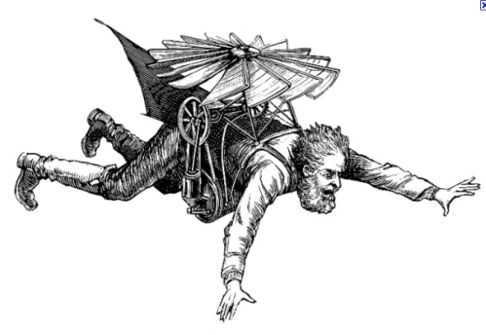
TVP

Slide 19
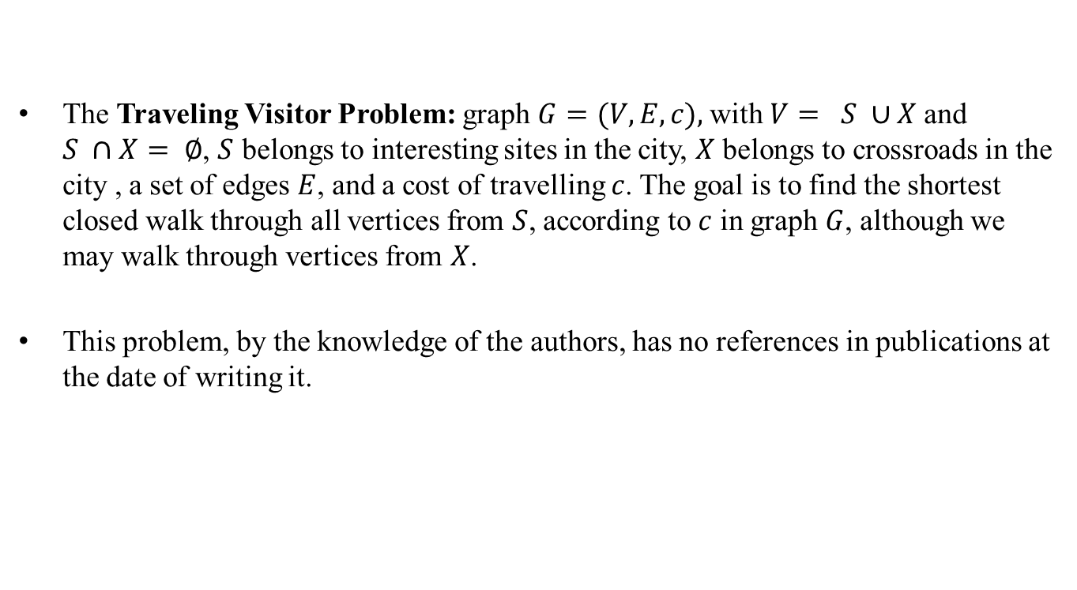
Traveling Visitor Problem
The Traveling Visitor Problem: graph $G=(V,E,c),$with $V= S ∪X$and $S ∩X= ∅$, $S$ belongs to interesting sites in the city, $X$ belongs to crossroads in the city , a set of edges $E$, and a cost of travelling $c$. The goal is to find the shortest closed walk through all vertices from $S$, according to $c$ in graph $G$, although we may walk through vertices from $X$.
This problem, by the knowledge of the authors, has no references in publications at the date of writing it.

Slide 20
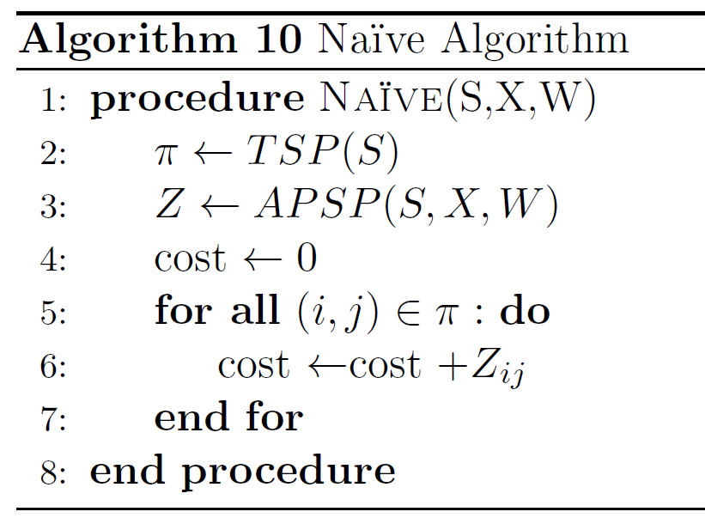
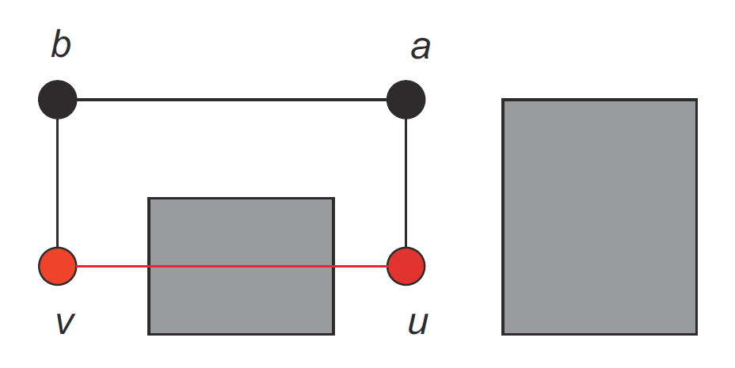
Algorithms for Solving TVP
The simplest approach of solving TVP is to visit all places as are ordered in the city’s tourist maps and then come back to the starting site.

Slide 21
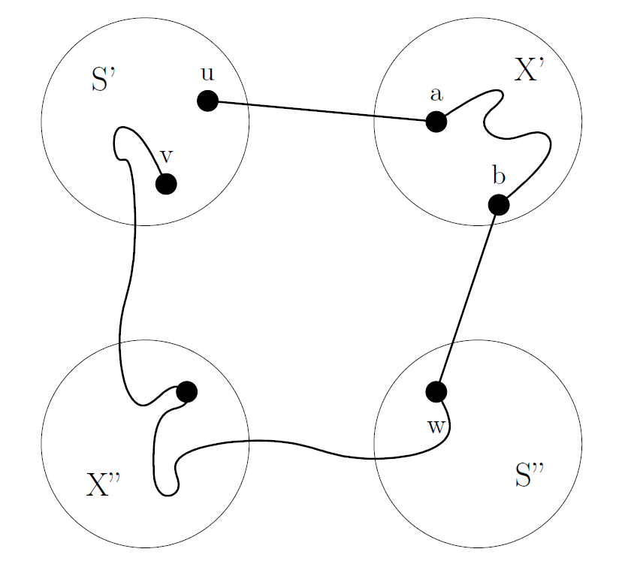
Adapted Floyd−Warshall algorithm

Slide 22
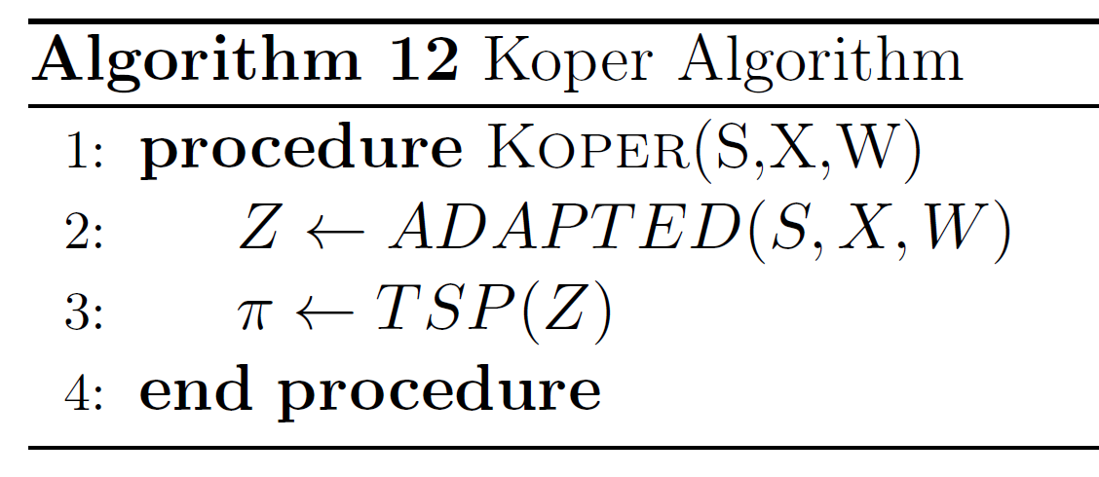

Algorithms for Solving TVP

Slide 23
Experiment
Instances: Koper, Belgrade (x2) and Venice.
Two artificial instances from TSPLIB: lin318 and pr1002.
Tested Methods: Naive and Koper.

Slide 24
Results
Name | (V) | (S) | Methods | Tour Cost | Difference
Koper | 120 | 55 | Naïve | 4738 | 17.22%
 |  |  | Koper | 4042
Belgrade | 163 | 53 | Naïve | 100389 | 6.52%
 |  |  | Koper | 94246
 | 250 | 90 | Naïve | 122119 | 8.77%
 |  |  | Koper | 112275
Venice | 210 | 72 | Naïve | 26648 | 24.24%
 |  |  | Koper | 21448
lin318 | 318 | 159 | Naïve | 921499 | 249.08%
 |  |  | Koper | 263983
pr1002 | 1002 | 501 | Naïve | 11818732 | 354.46%
 |  |  | Koper | 2600585

Slide 25
Results
Koper120
Venice210
Belgrade250

Slide 26
Outline
Motivation
Contribution to Science
Introduction
  Traveling Salesman Problem (TSP)
  Methods for Solving TSP
Grafted GA for the TSP
  Experiments
  Evaluation
Traveling Visitor Problem (TVP)
  Experiments
  Evaluation
Contribution to Science
Conclusions

Slide 27
Contribution to Science
Contributions to the science consist of the following results:
Construction of the GGA for solving the TSP.
Insights of different levels and places of hybridization for GGA.
Construction of the method for solving the TVP.
Construction of improved FW algorithm for APSP.
Solutions of the TVP for cities of Koper, Belgrade and Venice.

Slide 28
Contribution to Science
The results of PhD Thesis are published in the following articles:
M. Djordjevic, Influence of Grafting a Hybrid Searcher Into the Evolutionary Algorithm, Proceedings of the 17th International Electrotechnical and Computer Science Conference, Portoroz, Slovenia (2008), 115–118.
M. Djordjevic, M. Tuba, and B. Djordjevic, Impact of Grafting a 2-opt Algorithm Based Local Searcher Into the Genetic Algorithm, Proceedings of the 9th WSEAS international conference on Applied informatics and communications, AIC 2009, Moscow, Russia (2009), 485–490.
M. Djordjevic, and A. Brodnik, Quantitative Analysis of Separate and Combined Performance of Local Searcher and Genetic Algorithm, Book of Abstract of International Conference on Operations Research, OR 2011, Zurich, Switzerland (2011), 130.
M. Djordjevic, and A. Brodnik, Quantitative Analysis of Separate and Combined Performance of Local Searcher and Genetic Algorithm, Proceedings of the 33rd International Conference on Information Technology Interfaces, ITI 2011, Dubrovnik, Croatia (2011), 515–520.
M. Djordjevic, M. Grgurovic and A. Brodnik, The Traveling Visitor Problem and the Koper Algorithm for Solving It, Book of Abstracts of 25th Conference of European Chapter on Combinatorial Optimization, ECCO 2012, Antalya, Turkey (2012), 10.
M. Djordjevic, M. Grgurovic and A. Brodnik, The Traveling Visitor Problem and Algorithms for Solving It, Book of Abstracts of 3rd Student Conference on Operational Research, SCOR 2012, Nottingham, UK (2012), 26.
M. Djordjevic, J. Zibert, M. Grgurovic, and A. Brodnik Methods for Solving the Traveling Visitor Problem, Proceedings of the 1st International Internet and Business Conference, IBC 2012, Rovinj, Croatia (2012), 174–179.
M. Djordjevic, M. Grgurovic, and A. Brodnik, Performance Analysis of Partial Use of Local Optimization Operator on Genetic Algorithm for Traveling Salesman Problem, Business Systems Research, Print ISSN 1847-8344; Online ISSN 1847-9375, in press.

Slide 29
Conclusion
GGA
Results on examples from TSPLIB show that GGA method combines good qualities from both methods applied and outperforms each individual method.
The quality of solution also improves as we increase the hybridization.
Even small hybridization of 10% drastically improves solution.
TVP
Description of a new problem from graph theory, named the Traveling Visitor Problem (TVP).
The new problem is similar to the TSP, when we try to solve it with Naïve Algorithm we get solutions far from optimal.
In all tested cases the Koper Algorithm outperforms the Naïve Algorithm for solving the Traveling Visitor Problem.

Slide 30
Q & А
Thank You

