Slide 1
The Traveling Visitor Problem and Algorithms for Solving It
Seminar MARA
Milan Djordjevic
Joint work with Marko Grgurovic and Andrej Brodnik
Department of Information Science and Technology (DIST), Koper, Slovenia: milan.djordjevic@student.upr.si

Slide 2
Outline
Introduction
  Traveling Salesman Problem (TSP)
  All-Pairs Shortest Path Problem (APSP)
  Methods for Solving TSP
Traveling Visitor Problem (TVP)
Algorithms for solving TVP
Experiment
Result
Conclusions

Slide 3
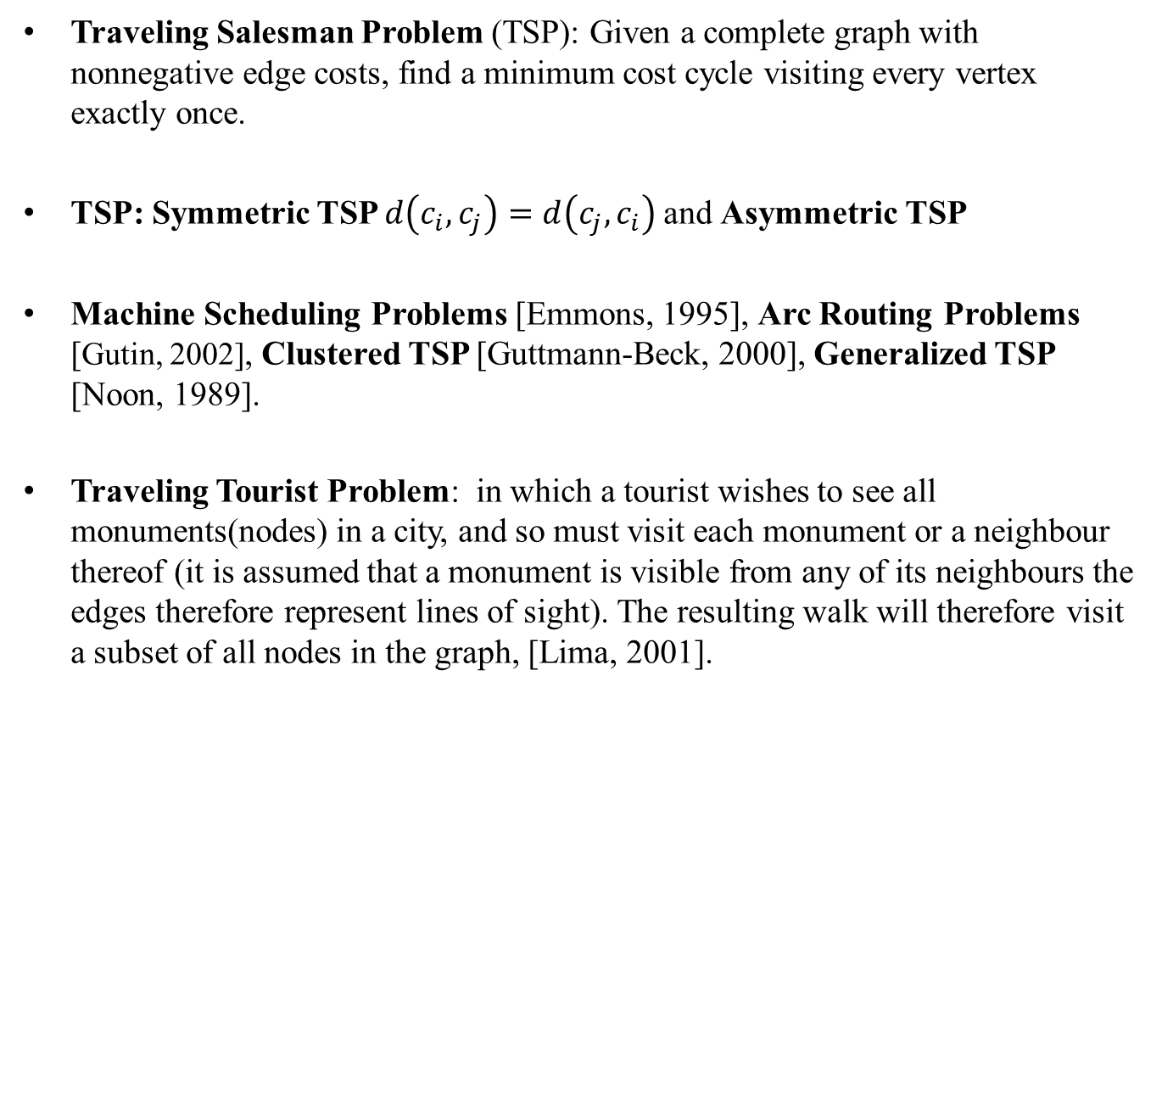
Introduction - TSP
Traveling Salesman Problem (TSP): Given a complete graph with nonnegative edge costs, find a minimum cost cycle visiting every vertex exactly once.
TSP: Symmetric TSP $d\left(c_{i}, c_{j}\right)=d\left(c_{j}, c_{i}\right)$and Asymmetric TSP
Machine Scheduling Problems [Emmons, 1995], Arc Routing Problems [Gutin, 2002], Clustered TSP [Guttmann-Beck, 2000], Generalized TSP [Noon, 1989].
Traveling Tourist Problem: in which a tourist wishes to see all monuments(nodes) in a city, and so must visit each monument or a neighbour thereof (it is assumed that a monument is visible from any of its neighbours the edges therefore represent lines of sight). The resulting walk will therefore visit a subset of all nodes in the graph, [Lima, 2001].

Slide 4
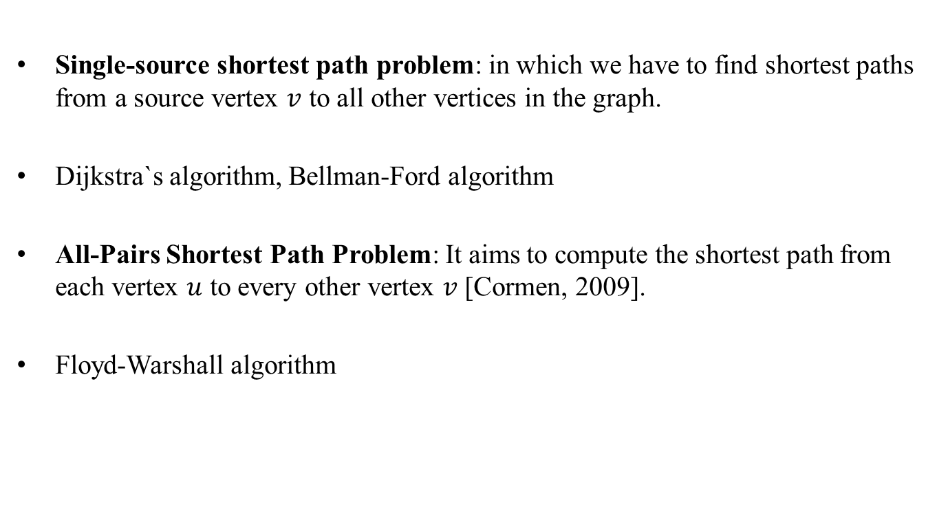
Introduction - APSP
Single-source shortest path problem: in which we have to find shortest paths from a source vertex $v$ to all other vertices in the graph.
Dijkstra`s algorithm, Bellman-Ford algorithm
All-Pairs Shortest Path Problem: It aims to compute the shortest path from each vertex $u$ to every other vertex $v$ [Cormen, 2009].
Floyd-Warshall algorithm

Slide 5
Introduction - Methods for Solving
Greedy algorithm [Bentley,1992].
A local search algorithm [Flood, 1956].
Grafted Genetic Algorithm: [Djordjevic, 2010].
This algorithms can solve the ATSP.
Lin-Kernighan Algorithm [Helsgaun, 2002].
The Concorde TSP Solver [Mulder, 2003]

Slide 6
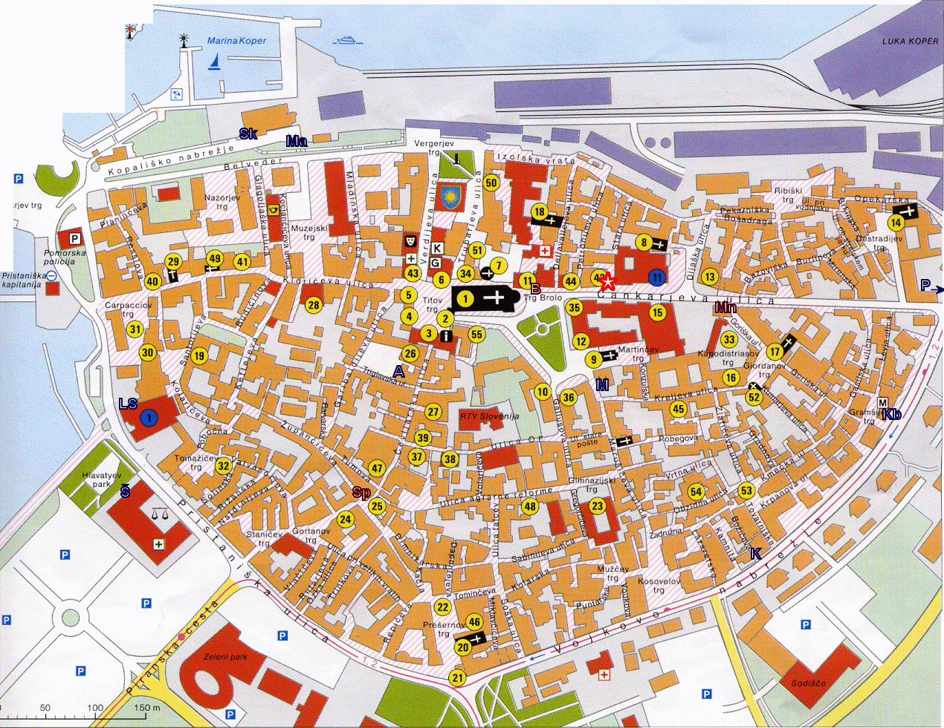
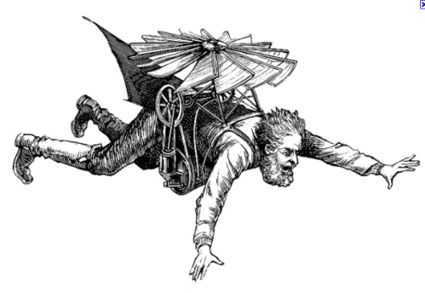
TVP

Slide 7
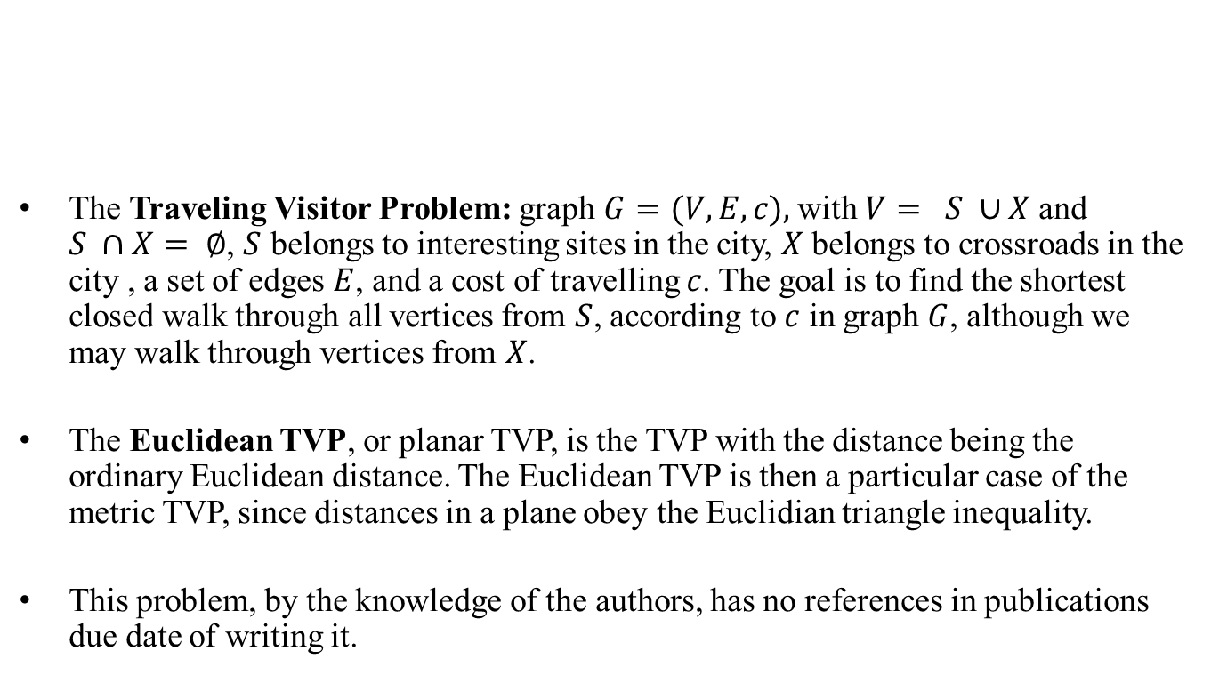
Travelling Visitor Problem
The Traveling Visitor Problem: graph $G=(V,E,c),$with $V= S ∪X$and $S ∩X= ∅$, $S$ belongs to interesting sites in the city, $X$ belongs to crossroads in the city , a set of edges $E$, and a cost of travelling $c$. The goal is to find the shortest closed walk through all vertices from $S$, according to $c$ in graph $G$, although we may walk through vertices from $X$.
The Euclidean TVP, or planar TVP, is the TVP with the distance being the ordinary Euclidean distance. The Euclidean TVP is then a particular case of the metric TVP, since distances in a plane obey the Euclidian triangle inequality.
This problem, by the knowledge of the authors, has no references in publications due date of writing it.

Slide 8
TVP

Slide 9
Algorithms for Solving TVP
One possible method is motivated by the intuitive thinking of a tourist when the concerned get in possession of a tourist map.

Slide 10
Adapted Floyd−Warshall algorithm
Line 2 finds the all-pairs shortest paths between
the vertices in X, but using only vertices from X
on the paths themselves.
Lines 3 through 9 finds every shortest path
starting in X and ending in S, by going through
vertices in X only.
Lines 10 through 16 finds every shortest path
starting in some vertex in S, going through some
vertex in X and ending in some vertex in S.
Finally, in Line 17 we run the Floyd-Warshall
algorithm on S. Since the sets S’ and S’’ have been
connected via shortest paths through X, we obtain
the APSP solution for S×S whereby the paths can
go through X.

Slide 11
Experiment
For testing our strategy and comparing it to other methods we used the real instances of the TVP, which were made from official tourist maps of cities of Koper, Belgrade and Venice.
From the publicly available library, TSPLIB, of sample benchmarks for the TSP and related problems, two instances of the STSP were taken, modified and tested.
5 instances were tried out, with different sizes which range from 120 to 1002 vertices per instance.
Tested Methods: Naive and Koper

Slide 12
Results
Name | (V) | (S) | Methods | Tour Cost | Difference
Koper | 120 | 55 | Naïve | 4738 | 17.22%
 |  |  | Koper | 4042 | 0.00%
Belgrade | 163 | 53 | Naïve | 100389 | 6.52%
 |  |  | Koper | 94246 | 0.00%
 | 250 | 90 | Naïve | 122119 | 8.77%
 |  |  | Koper | 112275 | 0.00%
Venice | 210 | 72 | Naïve | 26648 | 24.24%
 |  |  | Koper | 21448 | 0.00%
pr1002 | 1002 | 501 | Naïve | 11818732 | 354.46%
 |  |  | Koper | 2600585 | 0.00%
lin318 | 318 | 159 | Naïve | 921499 | 249.08%
 |  |  | Koper | 263983 | 0.00%

Slide 13
Results
Koper120
Venice210
Belgrade250

Slide 14
Summary and Conclusion
Description of a new problem from graph theory, named the Traveling Visitor Problem (TVP).
The tested benchmarks: Koper, Belgrade and Venice and two instances of modified cases from TSPLIB.
The new problem is similar to the TSP, when we try to solve it with Naïve Algorithm we get solutions far from optimal.
The minimum cost solutions for the TVP instances tested in the experiment are provided by Koper Algorithm.
In all tested cases the Koper Algorithm significantly outperforms other tested methods for solving the Travelling Visitor Problem.
The future tourist maps could be reordered according to the results of this experiment.

Slide 15
Q & А
Thank You

